Slide 1
Locked down in distress: a causal estimation of the mental-health fallout from the COVID-19 pandemic
Lina Anaya | Peter Howley | Muhammad Waqas | Gaston Yalonetzky
University of Bradford | University of Leeds | University of Bradford | University of Leeds
Workshop on Mental Health and the COVID-19 Pandemic
4 April 2022

Slide 2
Outline
Introduction: motivation & research questions
Data & research design
Results question #1: impact of the first wave of the pandemic on mental health
The effect is about 50% to 67% of the estimated effect for unemployment
Results question #2: why was the pandemic detrimental for mental health?
Health anxiety, social isolation, and crowding stress are important mediators
Conclusions

Slide 3
The Covid-19 pandemic has been one of the most significant public health crisis of our time
COVID-19 restrictions had economic costs (Goolsbee & Syverson, 2021; Gupta et al., 2020; Rojas et al., 2020)
The pandemic was associated with a substantive rise in psychological distress (Banks et al., 2021)
Having a better understanding of the consequences of the pandemic is important to create more informed policies in response to this or indeed future pandemics

Slide 4
Understanding who could be more affected by current/future pandemics is also important
It can help to inform and target policies that could mitigate or minimise these detrimental impacts
Women, ethnic minorities, young adults and working parents have been disproportionately impacted on their mental well-being during the pandemic (Banks & Xu, 2020; Cheng et al., 2021; Daly et al., 2020; Etheridge & Spantig, 2020; Giovanis & Ozdamar, 2020; Niedzwiedz et al., 2021; Swaziek & Wozniak, 2020; Zamarro & Prados, 2021)

Slide 5
In this paper
We contribute to the existing literature by employing a Diff-in-Diff method:
Q1: Evaluate the causal impact of the initial wave of the pandemic on mental health in the UK
Q2: What factors/mechanisms lie behind these detrimental mental health impacts
This quasi-experimental framework allows us to more reliably calculate the impact of the pandemic and the resulting social restrictions for mental health

Slide 6
Data
We use data from the UK Household Longitudinal Study (UKHLS or Understanding Society) and the UKHLS COVID panel
Panel that follows UK households over time and collects a wide range of information such as social, economic, and behavioural factors
The advantage is the availability of pre and post pandemic data of mental health
It allows implementing a quasi-experimental approach

Slide 7
The lockdown announcement in the UK as a cut-off to evaluate the role of the first wave of the pandemic
The first lockdown in the UK was announced on March 23, 2020
Implemented one day after the announcement
Restrictions:
Stay-at-home, police-enforced order
People could only be outside to buy food or medication, exercise alone once a day, or to travel to work if absolutely necessary
Gatherings of maximum two people
All non-essential shops/businesses closed

Slide 8
What is the effect of the first wave of the pandemic on mental health in the UK?
Research question #1

Slide 9
Research design: difference-in-differences
$M_{it}=β_{0}+β_{1}L_{i}∗T_{i}+β_{2}L_{i}+β_{3}T_{i }+\sum_{k=1}^{n}{α_{k}X_{kit}}+\sum_{k=1}^{n}{γ_{k}X_{kit}L_{i}}∗T_{i}+ε_{it}$
$M_{it}$: corresponds to the mental heath of the individual $i$ reported on the interview date $t$
General Health Questionnaire (GHQ) 12-item scale that assesses somatic symptoms, anxiety and insomnia, social dysfunction, and general happiness
Ranges from 0 (lowest) to 36 (highest) mental distress

Slide 10
Research design: difference-in-differences
$M_{it}=β_{0}+β_{1}L_{i}∗T_{i}+β_{2}L_{i}+β_{3}T_{i }+\sum_{k=1}^{n}{α_{k}X_{kit}}+\sum_{k=1}^{n}{γ_{k}X_{kit}L_{i}}∗T_{i}+ε_{it}$
$L_{i}$: interview Post Lockdown is a dummy variable that takes the value of one if the individual was interviewed after March the 23rd
$T_{i }$: Jun2019-May2020 is a dummy that takes the value of one if the interview occurs between June 1st, 2019 and May 31st, 2020

Slide 11
Research design: difference-in-differences
$M_{it}=β_{0}+β_{1}L_{i}∗T_{i}+β_{2}L_{i}+β_{3}T_{i }+\sum_{k=1}^{n}{α_{k}X_{kit}}+\sum_{k=1}^{n}{γ_{k}X_{kit}L_{i}}∗T_{i}+ε_{it}$
$X_{kit}$ is a vector with dummies of demographic characteristics such sex at birth, BAME identity (i.e., Black, Asian, and Minority Ethnic), born outside the UK, and indicators for age groups
$ε_{it}$ corresponds to the error term

Slide 12
Research design: difference-in-differences
Mental Distress (M)
Pre-lockdown
Post-lockdown
$$∆M=$$
$$\left(Post−Pre\right)$$
$$−(June2019 to May2020 −June2018 to May2019)$$
June 2019 to May 2020
June 2018 to May 2019
$$β_{1}L_{i}∗T_{i}$$
March 23rd
Interview date (t)

Slide 13
Results of the first pandemic wave impact on mental health
Research Question #1

Slide 14
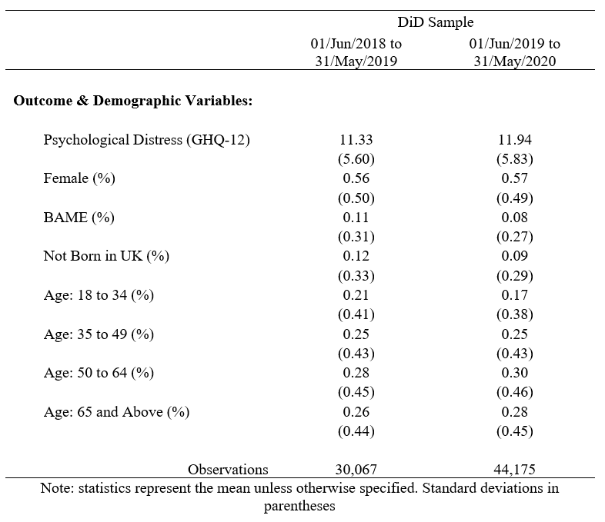
Our sample is roughly half female
Between 8% to 12% are BAME or not born in the UK

Slide 15
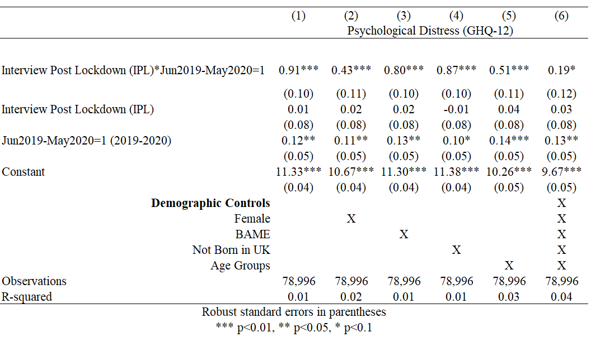
Difference-in-differences estimated impact of the first wave of the pandemic

Slide 16
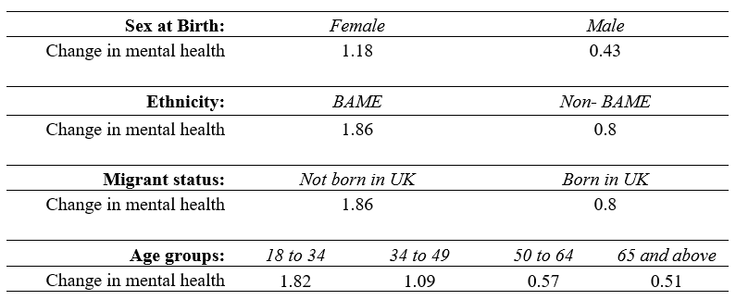
How heterogeneous is the impact of the lockdown on mental distress?
+
-

Slide 17
Why was the pandemic so detrimental for mental health?
Research question #2

Slide 18
Why was the pandemic so detrimental for mental health?
To understand the mental distress experienced in the UK during the first wave of the pandemic we evaluate the following mechanisms:
Financial worries:
Subjective financial health: from 1 to 5 how well are you managing your finances? where 1 is “Living comfortably” and 5 is “Finding it very difficult”
People who have financial worries could experience higher levels of mental distress during the first wave of the pandemic

Slide 19
Why was the pandemic so detrimental for mental health?
To understand the mental distress experienced in the UK during the first wave of the pandemic we evaluate the following mechanisms:
Health anxiety:
Chronic health: self-reported data on whether people suffer any chronic health condition
Health-related anxiety should be much more apparent for those with these chronic health conditions
Health conditions associated with severe COVID-19 complications (Ejaz et al., 2020; Gasmi et al., 2021; Treskova-Schwarzbach et al., 2021; PHE; 2020)
Notes:
Cardio vascular, cerebrovascular, respiratory, diabetes etc…

Slide 20
Why was the pandemic so detrimental for mental health?
To understand the mental distress experienced in the UK during the first wave of the pandemic we evaluate the following mechanisms:
Social isolation:
Loneliness: how often do you feel lonely? Often, sometimes, hardly ever or never
Social interaction is beneficial for mental health and to prevent feelings of loneliness (Child & Lawton, 2017; d’Hombres et al. 2021; ONS, 2018; Tulane University, 2020)

Slide 21
Why was the pandemic so detrimental for mental health?
To understand the mental distress experienced in the UK during the first wave of the pandemic we evaluate the following mechanisms:
Crowding stress:
Overcrowding: we divide the total number of people living in the household by the number of bedrooms in their dwelling unit
Being constrained to one’s home for long periods can result in crowding stress (Aiello et al., 1981; Regoeczi, 2008)
Crowding stress and density are related. When density is high it can lead to crowding stress (Churchman 1999, Evans and Cohen 1987)

Slide 22
Results of the mechanisms behind the overall mental distress during the first lockdown
Research question #2

Slide 23
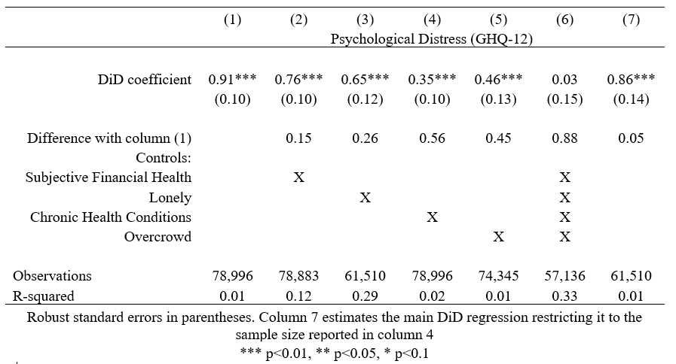

Slide 24
Conclusions

Slide 25
Conclusions
The overall impact of the first wave of the pandemic is substantial:
This effect represents between 50% and 67% of the estimated disutility associated with unemployment and it is even larger compared to that of divorce and widowhood (Howley & Knight, 2021; Flint et al., 2013)
In the UK, the mental health burden associated with the pandemic is bigger for women, younger age groups, BAME groups, and migrants
Health anxiety, social isolation, and crowding stress play a prominent role on explaining why the pandemic was detrimental to mental health
We also find that financial health has some effect but not as big as compared to the other mechanisms

Slide 26
Thank you!
Lina Anaya
l.anaya@bradford.ac.uk
@lina_Anaya
Lina Anaya

Slide 27
Appendix

Slide 28
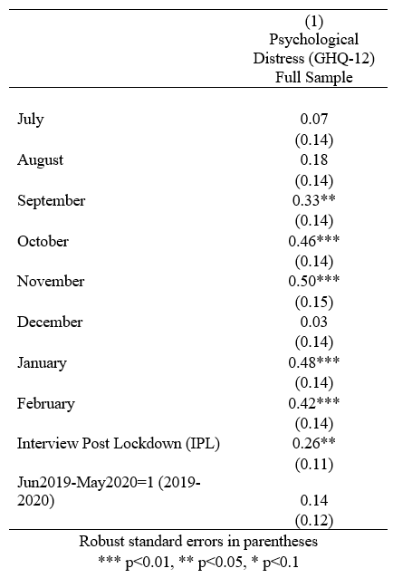
Pre-trends test

Slide 29
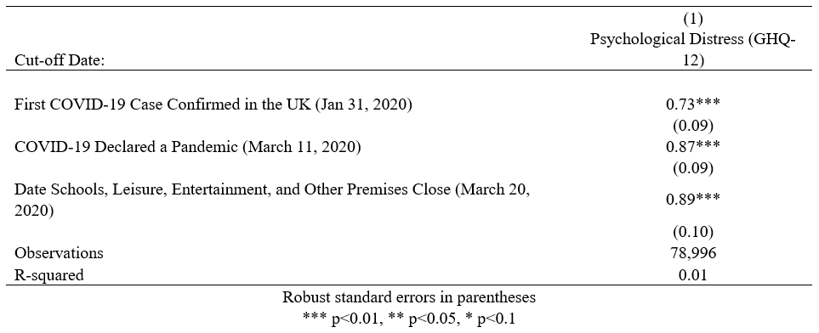
Summary of difference-in-differences estimates employing alternative cut-off dates

Slide 30
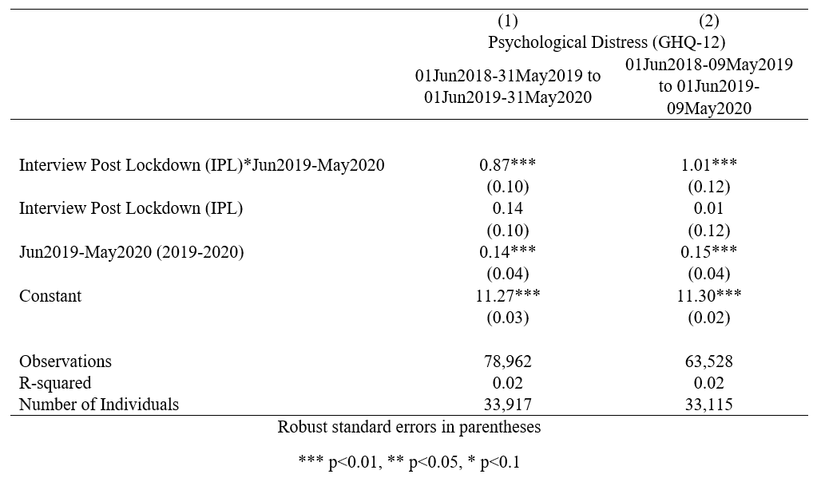
Difference-in-differences-fixed-effects estimates

Slide 31
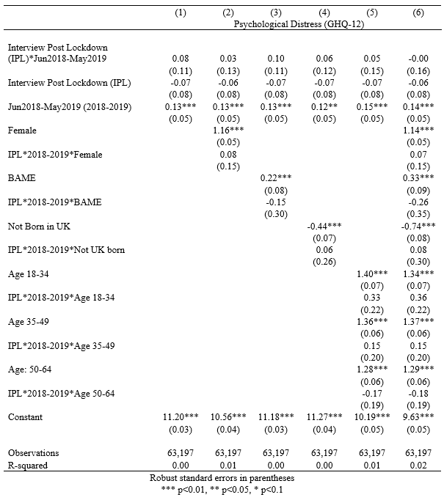
Difference-in-differences placebo estimates (01-Jun-2018/31-May-2019 to 01-Jun-2019/31-May-2020)

